Slide 1
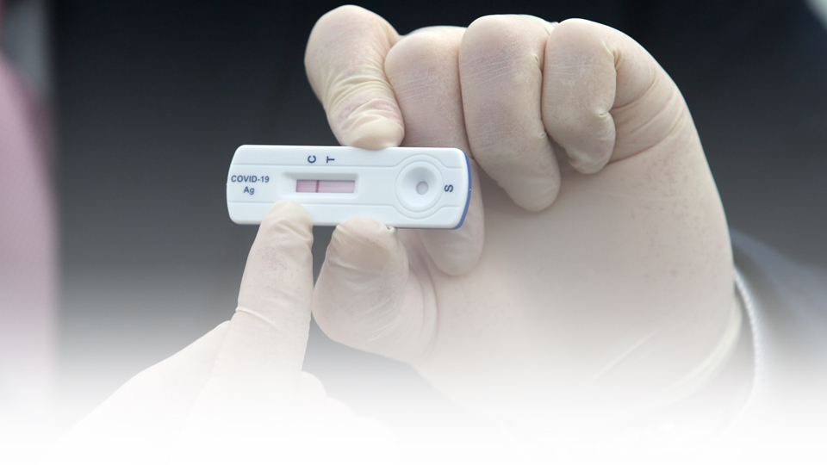


INTERIM REPORT–
COMPETITIVE INTELLIGENCE STUDY –
SELECTED MANUFACTURES OF RAPID ANTIGEN TEST KITS IN GLOBAL MARKET
Prepared For：
Prepared By：
TSR/2020/353
February 23, 2022
www.techsciresearch.com

Slide 2
Report Content
Sl. No.
Report Content
Page No.
1
TARGET MANUFACTURERS PROFILE
4-13
2
REGULATORY APPROVALS IN TARGET COUNTRIES
15-19

Slide 3
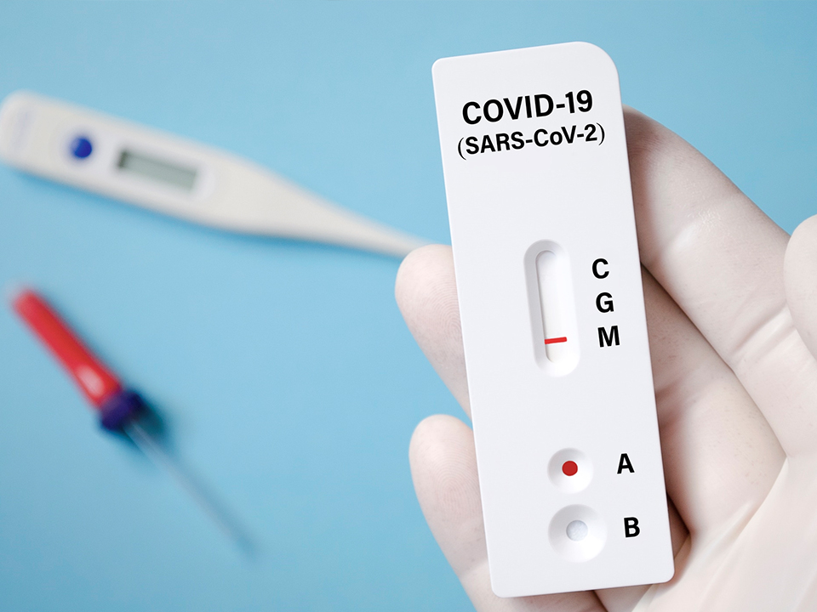
TARGET MANUFACTURERS PROFILE

Slide 4

Abbott, USA
Overview:
Abbott is a global healthcare company with headquarters in Chicago, Illinois, USA. The company generates approximately 70% revenue from markets outside USA. It operates in four major business segments namely, nutrition, diagnostics, medical devices, and pharmaceuticals. Abbott has global presence in more than 160 countries. Abbott claims to be a market leader in segments such as point of care testing, glucose monitoring, blood and plasma screening, adult nutrition, heart pups (LVADs), remote heart failure monitoring, and chronic pain devices.
Rapid Antigen Test Kit Business
Rapid Antigen Kit
Abbott markets its rapid antigen testing under the brand name of BinaxNOW, and Panbio.
BinaxNOW is a self test rapid antigen test kit. It can detect both asymptomatic and symptomatic COVID-19 using nasal swab. BinaxNOW is based on Abbott’s lateral flow technology which detects nucleocapsid protein antigen from SARS-CoV-2.
The Food and Drug Administration (FDA) has also issued Emergency Use Authorization (EUA) for BinaxNOW COVID-19 Ag Card rapid test for detection of COVID-19 infection.
Panbio is marketed outside USA and is similar to BinaxNOW in terms of manufacturing processes.
It has sensitivity of 98.1% (99.0% for samples with Ct values ≤ 33) when a nasal swab is taken and 91.4% (94.1% for samples with Ct values ≤ 33) when nasopharyngeal swab is taken.
Panbio is CE marked and WHO Emergency Use Listing Procedure (EUL) approved.
Manufacturing Unit Location (3): USA (Illinois, and Maine), South Korea (Seoul), Germany (Jena )
Cumulative Production Capacity: 1,140 million units per year.
Abbott plans to increase the cumulative manufacturing capacity by adding 30 million units per month to meet the demand , primarily for the government sector across countries

Slide 5
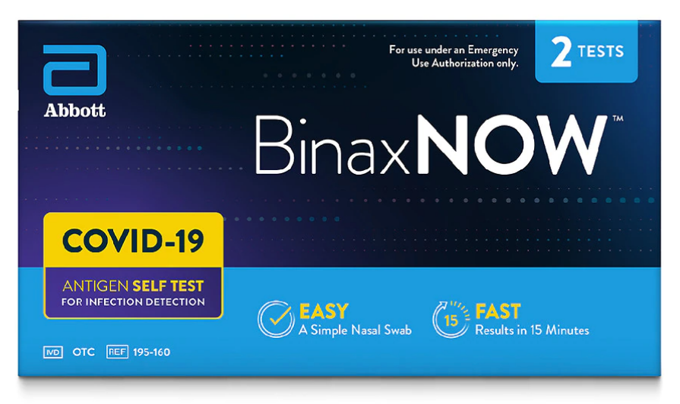
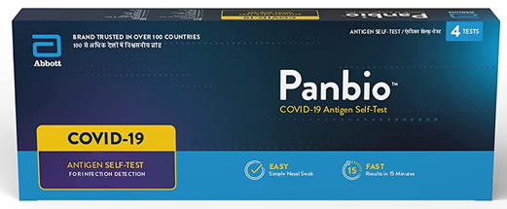
Abbott, USA
Plant Location Benchmarked : Illinois, USA
Production Capacity: 70 million units per month
Automation of the Production Line (Manual/ Semi/ Automatic): Manual production line (Abbott is in process of automating the rapid antigen kit manufacturing facility).
Manufacturing Cost Per Unit: USD 2.25/Kit
Raw Material Cost: USD 1.35/Kit
Process Cost: USD 0.70/Kit
Packaging Cost: USD 0.20/Kit
Lead Time of Building The Production Line: 12 weeks. The production line is installed within the existing production plant of other products

Slide 6

Roche
Overview:
Roche is a global pharmaceuticals and diagnostics company with headquarters in Basel, Switzerland. The company has presence in over 100 countries globally. Under its diagnostics division, Roche offers in vitro diagnostics solutions, covering molecular diagnostics, clinical chemistry and immunoassays, tissue diagnostics, point of care testing, patient self-testing, next-generation sequencing, and laboratory automation and IT, and decision support solutions.
Rapid Antigen Test Kit Business
Rapid Antigen Kit
Elecsys SARS-CoV-2 Antigen test is the brand name , which uses nasal swab and provides result in less than 20 minutes.
It is a rapid chromatographic immunoassay designed to qualitatively detect a specific antigen of SARS-CoV-2 present in human nasopharynx.
The test has a sensitivity of 96.52% and a specificity of 99.68%. It has 99.5 % specificity (95 % CI: 98.63 – 99.85 %).
It serves the purpose to aid and assess the adaptive humoral immune response to the SARS‑CoV‑2 S protein.
Test Kit is CE marked but has not been FDA-cleared or approved; it has been authorized by FDA under an Emergency Use Authorization (EUA) for use by authorized laboratories.
In-addition to the manufacturing unit of own brand (Elecsys SARS-CoV-2 ), Roche has a global distribution agreement with Korea based SD Biosensors for distributing their rapid antigen test kits . This partnership also includes agreement that covers global distribution of various tests launched by SD Biosensor during the pandemic.
SD Biosensors has manufacturing unit is Seoul Korea, India and other countries for manufacturing antigen kits
Manufacturing Unit Location(1): Indianapolis, USA (Roche Manufacturing Unit)
Cumulative Production Capacity: 480 million units per year

Slide 7
Roche
Business Strategies
In collaboration with SD Biosensor, Inc., the company launched SARS-CoV-2 rapid antigen test in countries accepting the CE mark and planned to file for an EUA in the first quarter of 2021.
For supporting the high demand of SARS-CoV-2 testing, the company increased the production capacity to unparalleled levels.
The company assured that these tests, systems and consumables are made available in the most effective way by adopting certain allocation strategies.
To maximize the production, multiple task forces were created while maintaining the health and safety of manufacturing personnel.
Roche quickly began the shipping of SARS-CoV-2 rapid antigen test kit to leading laboratories globally and ramped up the production capacity to high double-digit millions per month for serve healthcare systems in the US and in the CE mark accepted countries.
They allowed hospitals and reference laboratories to run the test on Roche’s cobas e analysers, widely available around the world.
Supply Chain Strategies
The company followed On-Time-In-Full (OTIF) supply chain strategy for the supply of rapid antigen test kit, delivering the full quantity requested by the customer on the specific date, sustaining with more than 97% of their supply.
Roche also maintained finished goods order lead time of about 30 days for 80% sale.
Roche had begun implementing OMP as its supply chain planning system of record which covers all operational supply chain planning aspects which includes master production planning, distribution planning, materials requirements planning and detailed scheduling, from packaging materials to finished goods. This strategic investment helped the company in improving the speed and quality of decision making in the supply chain planning.
Roche also shifted from old warehouses to newly automated distribution centers for the efficient supply of test kits.

Slide 8
Roche
Human Resource Strategies
The company created more than 1000 new jobs worldwide for supporting the high demand for SARS-CoV-2 testing and significantly increased the production capacity.
Digital solutions were adopted for People & Culture at Roche, especially their move from on-premise to cloud-based platforms, have helped them to live into their vision of “Anyone working Anytime, Anywhere from Any device”.
They digitized majority of their processes and document management which helped them to pay, hire, move and develop employees without any disruption.
QMS Strategies
The company possesses the certification of ISO 13485:2016 which is for medical devices – quality management systems ensuring all the measures are being followed by the company to meet the customer and applicable regulatory requirements.
Roche filed for Emergency Use Authorization (EUA) from the U.S. Food and Drug Administration on 11 December 2020.
The laboratory based Elecsys SARS-CoV-2 Antigen test had also obtained the import license from Central Drugs Standard Control Organization, India on 8th June 2021.
The company follows a structured system of procedures and processes which covers all aspects manufacturing, design, risk management, clinical data, distribution, storage, product labeling, supplier management and complaint handling.

Slide 9

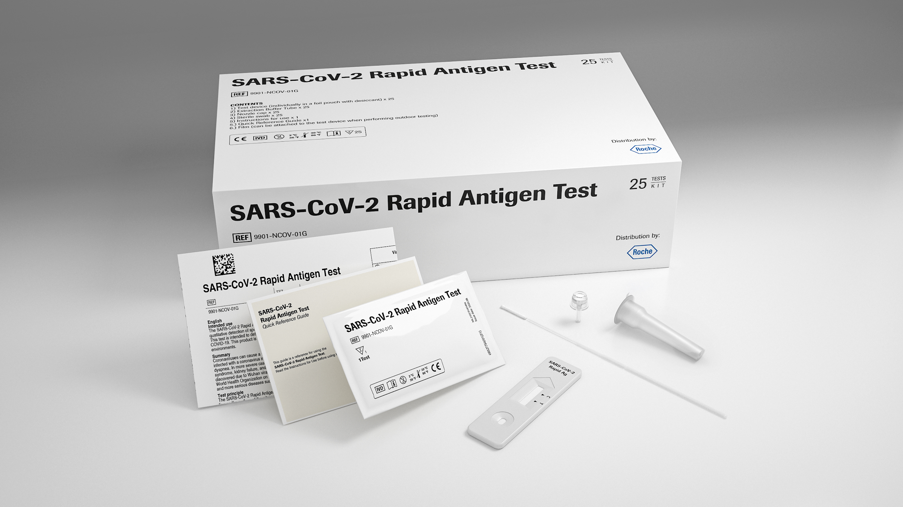
Roche
Plant Location Benchmarked : Indianapolis, USA
Production Capacity: 40 million units per month
Automation of the Production Line ( Manual/ Semi/ Automatic): Manual production line
Manufacturing Cost Per Unit: USD 3.50/Kit
Raw Material Cost: USD 2.00/Kit
Process Cost: USD 1.30/Kit
Packaging Cost: USD 0.20/Kit
Lead Time of Building The Production Line: 9 weeks. The production line is installed within the existing production plant of other products

Slide 10

Guangzhou Wondfo Biotech Co., Ltd.
Overview:
Guangzhou Wondfo Biotech Co., Ltd. is a China based POCT provider, established in 1992. The company focuses on R&D, manufacturing, sales and service of rapid diagnostic reagents and equipment. Wondfo Biotech has presence in more than 140 countries providing over 300 clinical test items and serving more than 20,000 medical institutions. Wondfo has developed nine technology platforms which include the immune colloidal gold, immune-fluorescence, electrochemistry, dry biochemistry, chemiluminescence, molecular diagnostics, instrument, pathology, and biological raw material based on which it develops the product lines.
Rapid Antigen Test Kit Business
Rapid Antigen Test Kit
Guangzhou Wondfo Biotech’s rapid antigen test is sold under the brand name of Wondfo 2019-nCoV Antigen Test.
It is based on lateral flow method and uses non-invasive nasopharyngeal/oropharyngeal/nasal/saliva/sputum swab samples.
Wondfo 2019-nCoV Antigen Test provides instant results within 15 minutes.
The test is like RT-PCR, and the detection of antigen indicates active infection.
It has sensitivity of 98.11% (95% CI:95.24% ~ 99.48%), and specificity of 99.72% (95% CI: 98.47% ~ 99.99%).
It is FDA approved and CE certified having a shelf life of 12 months and 24 months depending upon the swab taken.
Manufacturing Unit Location (1): Guangzhou, China
Cumulative Production Capacity: 480 million units per year

Slide 11

Guangzhou Wondfo Biotech Co., Ltd.
Plant Location Benchmarked : Guangzhou, China
Production Capacity: 40 million units per month
Automation of the Production Line ( Manual/ Semi/ Automatic): Automatic production line
Manufacturing Cost Per Unit: USD 2.00/Kit
Raw Material Cost: USD 1.25/Kit
Process Cost: USD 0.60/Kit
Packaging Cost: USD 0.15/Kit
Lead Time of Building The Production Line: 5 weeks . The production line is installed within the existing production plant of other products

Slide 12

OEM (Xiamen Biotime Biotechnology) For Innova Medical Group, USA
Overview:
Innova Medical Group is a wholly owned subsidiary of private equity firm Pasaca Capital, Inc. and is headquartered in California, USA. It specializes in screening, testing and diagnostics for cancer, heart disease, arterial calcification, stroke, and virus detection focused on infectious diseases. China-based Xiamen Biotime Biotechnology diagnostic healthcare company is the OEM for Innova Medical Group. Xiamen Biotime Biotechnology Co., Ltd. is involved in development, production, and sales of POCT in vitro diagnostic reagents.
Rapid Antigen Test Kit Business
Rapid Antigen Test Kit
Innova Medical Group’s rapid antigen test is sold under the brand name of Innova SARS-CoV-2 antigen test
Innova’s SARS-CoV-2 antigen test is a lateral flow immunochromatographic assay used to detect extracted nucleocapsid protein antigens specific to SARS-CoV-2 in swab specimens directly collected from individuals having COVID-19.
It has a sensitivity on symptomatic individuals of 97% and a specificity of 99%. It has more than 90% sensitivity for asymptomatic Covid-19 infection.
The test uses nasal/throat swab and gives results in 20 minutes.
Manufacturing Unit Location of OEM (Xiamen Biotime Biotechnology) : Fujian, China, Own Plant Location: USA (MPS Medical), France (In-process), UK ( Planned)
In April 2021, Innova Medical Group has acquired MPS Medical Inc. which would manufacture rapid antigen test kits for Innova. Its initial production capacity would be 5 million tests kits per day in the plant of MPS Medical in USA
In October 2021, Innova Medical Group inaugurated its first rapid antigen test production line in Loiret, France. The company has entered in a partnership with AXYNTIS, a France based chemical manufacturing company; this partnership anticipates a possible ramp up which would increase the production capacity of more than 1 million tests per day.
Innova Group also plans to set up its own manufacturing plant in Rhymney, South Wales, UK.
Biotime has plans to increase the capacity to 16,000 million units per year

Slide 13

OEM (Xiamen Biotime Biotechnology) For Innova Medical Group, USA
Plant Location Benchmarked OEM (Xiamen Biotime Biotechnology) : Fujian, China:
Dedicated Production Capacity for Innova : 400 million units per month
Automation of the Production Line ( Manual/ Semi/ Automatic): Automatic
Manufacturing Cost Per Unit: USD 2.75/Kit
Raw Material Cost: USD 1.65/Kit
Process Cost: USD 0.90/Kit
Packaging Cost: USD 0.20/Kit
Lead Time of Building The Production Line: 8 weeks. The production line is installed within the existing production plant of other products

Slide 14

OEM (Healgen Scientific, LLC.) For Siemens Healthineers, Germany
Overview:
Siemens Healthineers AG is a German medical device company headquartered in Erlangen, Germany. It is a healthcare company providing various products and services including medical imaging, cancer care, laboratory diagnostics, point of care testing, clinical fields, digital health solutions, healthcare IT, and other services.
US-based Healgen Scientific, LLC. diagnostic healthcare company is the OEM for Siemens Healthineers. Healgen Scientific develops, manufactures, and commercializes in-vitro diagnostic test systems worldwide.
Rapid Antigen Test Kit Business
Rapid Antigen Test Kit
Siemens Healthineers rapid antigen test is sold under the brand name of CLINITEST Rapid COVID-19 Antigen Self-Test. The Antigen Testing Kit was launched in October 2020.
CLINITEST is intended for non -prescription home use kit for the qualitative detection of nucleocapsid protein antigen from SARS-CoV-2 and is easy to administer using either the nasal or nasopharyngeal swab methods.
It has a sensitivity of 86.5% and a specificity of 99.3% as against the nucleic acid (PCR) detection method and overall accuracy of 92.9%.
It provides a visually read, qualitative result within 15 minutes.
It has Emergency Use Authorization (EUA) provided by FDA.
The Antigen Test Kit is manufactured by Healgen Scientific LLC
Manufacturing Unit Location of OEM (Healgen Scientific, LLC.): Texas, USA

Slide 15

OEM (Healgen Scientific, LLC.) For Siemens Healthineers, Germany
Plant Location Benchmarked OEM (Healgen Scientific, LLC.) : Texas, USA:
Dedicated Production Capacity: 35 million units per month
Automation of the Production Line (Manual/ Semi/ Automatic): Manual
Manufacturing Cost Per Unit: USD 2.50/Kit
Raw Material Cost: USD 1.50/Kit
Process Cost: USD 0.80/Kit
Packaging Cost: USD 0.20/Kit
Lead Time of Building The Production Line: 14 weeks. The production line is installed within the existing production plant of other products

Slide 16
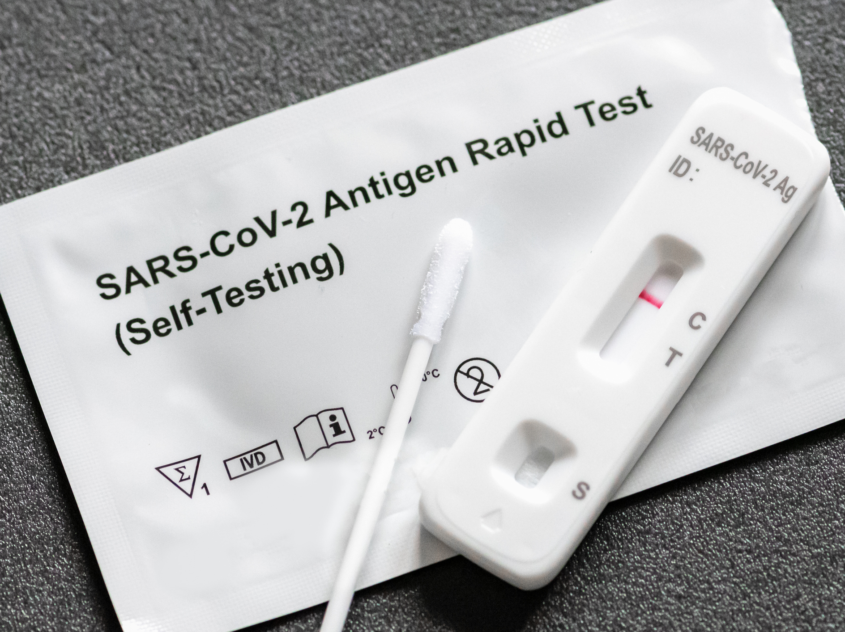
REGULATORY APPROVALS IN TARGET COUNTRIES

Slide 17

India
Covid-19 rapid antigen test kits fall under the ‘in-vitro diagnostic’ kit category under the Drugs and Cosmetics Act, 1940 (D&C Act) and Medical Devices Rules, 2017 (MD Rules). Therefore, these kits are regulated as medical devices. Drugs and Cosmetics Act, 1940 (D&C Act) is an act of Parliament of India regulating the import, manufacture and distribution of drugs in India. The main objective of this act is to ensure all and any drugs and cosmetics sold in India are safe and conform to the quality standards. Medical Devices Rules, 2017 (MD Rules) regulate the clinical investigation, manufacture, import, sale and distribution of medical devices in the country. If a company plans to manufacture a COVID-19 rapid antigen test kit in India, it would be required to go through the below-mentioned regulatory pathway before it can start commercial manufacturing of the kits::
Test License: A license from The Drugs Controller General of India (DCGI) is required to manufacture even small quantities of a rapid antigen test kit for clinical investigations, tests, evaluations, examinations, demonstrations or training. It enables the company to manufacture prototypes of the testing kit and carry out tests. Manufacturers can apply for such a license in standard forms required, which are Form MD-12 and issued in a started form ( Known as Form MD-13). The application for a test license should also include the following information:
brief description of the rapid antigen test kit, including intended use, material of construction, design and an undertaking stating that the required facilities, including equipment, instruments, and personnel, have been provided to manufacture such antigen test kit;
list of equipment, instruments;
list of qualified personnel;
copy of manufacturing licenses issued under the Medical Devices Rules, if any; and
approval letter authorizing to undertake research and development activities issued by any Government organization, if any.
Performance Evaluation of the Kit: As per Rule 59 of Medical Devices Rules (2017), after successful development of the testing kits, the same kits must be submitted for testing and clinical performance evaluation. These evaluations comply with existing testing standards that the ICMR sets in concordance with global practices. However, there is also a provision to fast track this process.
Following Rule 59(4) of the MD Rules, such requirements can be deferred/ waived of keeping in mind general public interest. Indian Council of Medical Research (ICMR) has designated various institutions such as the National Institute of Virology, Pune (NIV) for evaluation and fast tack validation of such kits.
Source: CDSCO, & ICMR

Slide 18
India
3. Manufacturing License/ Import License: After receiving a satisfactory report from ICMR / NIV / any other duly authorized testing institutes, the manufacturers must apply for a license to import/ manufacture COVID-19 rapid antigen test kits for import/manufacture for sale or distribution within India. This application should include supporting documents and information. The licensing authority should also inspect the manufacturing facility before granting a license. After following all these steps, a manufacturing license or loan manufacturing license is issued in standard Forms known as MD-9 or MD-10.
ICMR Regulations:
The Indian Council of Medical Research (ICMR) is a medical research body in India to formulate, coordinate, and promote biomedical research. ICMR had advised that rapid antigen test kits approved by European CE/IVD, Ministry of Food and Drug Safety, Korea, PMDA, Japan, TGA, Australia, Brazil ANVISA and WHO Emergency Use Listing (EUL) procedure may be exempted from validation in India and accorded marketing permission by DCGI based on existing approvals.
In view of this, SARS-CoV-2 rapid antigen tests approved only by the following agencies will not require separate validation in India:
United States Food and Drug Administration (USFDA), USA
Pharmaceuticals and Medical Devices Agency (PMDA), Japan
Therapeutic Goods Administration (TGA), Australia
WHO Emergency Use Listing (EUL) procedure
All test kits approved by any other global agency (besides those listed at 1-4) will be subject to validation in India by ICMR.
Points to be noted prior to approval of home-based testing solutions:
All home testing kits will be validated in India.
All manufacturers intending to market such tests in India must ensure the following:
All material for sample collection, testing and disposal should be part of the kit per se.
The kit insert should include detailed instructions for usage, interpretation and disposal of the test kit.
Source: CDSCO, & ICMR

Slide 19
India
All such tests must have an inbuilt system of data capture through mobile phone-based software.
All manufacturers are advised to liaise with the data entry team of ICMR to ensure compatibility of data flow into the ICMR COVID-19 testing portal. Once the compatibility is ensured, DCGI may be approached for approval.
Manufacturers who do not have a system or are unable to synchronize data flow with ICMR, may not be considered for marketing permission under the category of home-based testing solutions and considered for approval under another appropriate category.
This guidance is applicable for tests using nasopharyngeal, oropharyngeal, throat, nasal, oral, saliva, mouth rinse, gargle, blood and serum samples.
DCGI: Drugs Controller General of India (DCGI) is the head of department of the Central Drugs Standard Control Organization of the Government of India responsible for approval of licenses of specified categories of drugs such as blood and blood products, IV fluids, vaccines, and sera in India. Drugs Controller General of India, comes under the Ministry of Health & Family Welfare. DCGI also sets standards for manufacturing, sales, import, and distribution of drugs in India.
ICMR: The Indian Council of Medical Research (ICMR), the apex body in India for the formulation, coordination and promotion of biomedical research, is one of the oldest and largest medical research bodies in the world. The ICMR is funded by the Government of India through the Department of Health Research, Ministry of Health and Family Welfare. In 2007 the organization established the Clinical Trials Registry - India, which is India's national registry for clinical trials
Source: CDSCO, & ICMR

Slide 20

USA
FDA's Center for Devices and Radiological Health (CDRH) under the Federal Food, Drug, and Cosmetic Act (FFDCA) is responsible for regulating firms who manufacture, repackage, relabel, and/or import medical devices sold in the United States. As per US FDA, rapid antigen test kits fall under 'in-vitro diagnostic' kits of medical devices. The basic regulatory requirements that manufacturers of rapid antigen kits distributed in the U.S. must comply with are:
Establishment Registration: Any domestic or foreign manufacturer and initial distributor/importer of rapid antigen test kits must register their establishment with the FDA. All establishment registrations must be submitted electronically unless FDA has granted a waiver. All registration information must be verified annually between October 1st and December 31st of each year. In the case of foreign establishments, the designation of a U.S. Agent is also required. Most companies are required to pay an establishment fee as well.
Medical Device Listing: All manufacturers, contract manufacturers, re-packagers and re-labellers, specification developers, remanufacturers, manufacturers of accessories and components sold directly to the end-user, and U.S. manufacturers of "export only" devices must list their rapid antigen test kits with the FDA.
Premarket Notification 510(k), unless exempt, or Premarket Approval (PMA): Premarket Notification 510(k) by FDA is required for commercial distribution of rapid antigen kits in the USA. However, the Department of Health and Human Services (HHS) has announced that rapid antigen test kits do not require any guidance, compliance manuals, website statements, or other informal issuances concerning FDA premarket review of laboratory developed tests (LDTs) including in vitro diagnostic tests such as rapid antigen test kits.
FDA may not require premarket review for the rapid antigen tests or a notice and-comment rulemaking process. Per the announcement, premarket review includes premarket approval (PMA), premarket notification (510(k) notification). It also states that laboratories may voluntarily submit an EUA request, PMA, or 510(k) for rapid antigen test kits.
The EUA (Emergency Use Authorization) process is usually used to expedite access to medical products during an emergency that would otherwise require premarket approval. However, because premarket requirements for LDTs are generally waived through enforcement discretion by the agency, the EUA represents additional regulatory requirements for the clinical use of an LDT in an emergency.
Source: US FDA

Slide 21
USA
For molecular and rapid antigen tests, the guidance allows laboratories and commercial manufacturers to perform and manufacture their tests prior to receiving EUA, if they validate the test, notify FDA, and submit EUA materials within 15 days.
Investigational Device Exemption (IDE) for clinical studies: An investigational device exemption (IDE) permits the investigational device ( rapid antigen test kit) to be used in a clinical study for safety and effectiveness data collection required to support a Premarket Approval (PMA) application or a Premarket Notification 510(k) submission to FDA. An Approval is required by the FDA and an Institutional Review Board (IRB) for clinical studies with a rapid antigen test kit of significant risk. However, in case of rapid antigen with the kit with nonsignificant risk, only approval from the Institutional Review Board (IRB) is required before the study can begin.
Quality System (QS) regulation: The quality system regulation is required for the methods used in and the facilities and controls used for designing, purchasing, manufacturing, packaging, labelling, storing, installing, and servicing rapid antigen test kits. FDA inspections are done in manufacturing facilities to assure compliance with quality system regulation.
Labeling requirements: Labelling approvals include labels and descriptive and informational literature that accompanies the device.
Medical Device Reporting (MDR): Any incidents with rapid antigen test kits that may have caused or contributed to a death or serious injury must be reported to the FDA under the Medical Device Reporting program. Additionally, all malfunctions must also be reported to the FDA. The MDR regulation is a mechanism for FDA and manufacturers to identify and monitor significant adverse events involving medical devices. The goals of the regulation are to detect and correct problems promptly.
FDA: The United States Food and Drug Administration is a federal agency of the Department of Health and Human Services responsible for protecting the public health by ensuring the safety, efficacy, and security of human and veterinary drugs, biological products, etc.
Federal Food, Drug, and Cosmetic Act (FFDCA): The United States Federal Food, Drug, and Cosmetic Act is a set of laws giving authority to the U.S. Food and Drug Administration to oversee the safety of food, drugs, medical devices, and cosmetics.
Source: US FDA

Slide 22
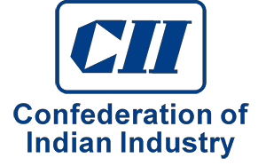






Disclaimer :
The contents of this report are based on information generally available to the public from sources and primary interviews which are believed to be reliable. No representation is made that it is timely, accurate or complete. TechSci Research has taken due care and caution in compilation of data as this has been obtained from various sources including primary interviews which it considers reliable and firsthand. However, TechSci Research does not guarantee the accuracy, adequacy or completeness of any information and it is not responsible for any errors or omissions or for the results obtained from the use of such information and especially states that it has no financial liability whatsoever to the subscribers / users of this report. The information herein, together with all estimates and forecasts, can change without notice. All the figures provided in this document are indicative of relative market size and are strictly for client’s internal consumption. Usage of the same for purpose other than internal will require prior approval of TechSci Research.
CONTACT US
TechSci Research – North America
2950, Boundary Road, Burnaby, British Columbia, Canada
Tel: +1- 646- 360-1656
E: sales@techsciresearch.com
TechSci Research – Europe
54, Oldbrook, Bretton,
Peterborough,
United Kingdom
E: sales@techsciresearch.com
TechSci Research – Asia-Pacific
B-44, Sector -57, Noida, National Capital Region, UP, India
Tel: +91-120-4523900
E: sales@techsciresearch.com
TechSci Research
Cyber City, Building No. 8C, Gurgaon, National Capital Region, Haryana, India
Tel: +91-124-6428661
E: sales@techsciresearch.com
www.techsciresearch.com
INDUSTRY ASSOCIATIONS
The information contained herein is of a general nature and is not intended to address any particular situation, individual or entity. No one should act upon such information without appropriate professional advice.
2021 © TechSci Research All Rights Reserved.

